Slide 1


DEPI| 2025
GRADUATION PROJECT
Presented by
ONL3_SWD6_G3
Instructor: Abdelrahman Ayman

Slide 2

DEPI| 2025
OUR TESTEING TEAM
Areeg Abdo
Reem Salah
Zahraa Mohamed
Ahmed Atef
Mahmoud Hamdy
Mohamed Abdelfattah

Slide 3
DEPI| 2025
AGENDA
STLC
Manual Testing
Data Base
API Testing
Automation Testing

Slide 4
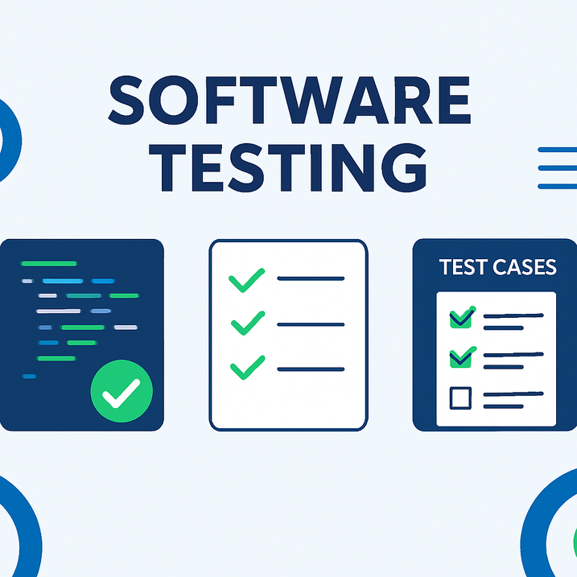
ONL3_SWD6_G3
INTRODUCTION
Software Testing Life Cycle.
Manual Testing(Exploratory Testing on OpenCart Website).
Data Base.
API Testing: using Postman on the Automation Exercise API.
Automation Testing: on the OpenCart website using Selenium with java.

Slide 5




ONL3_SWD6_G3
TOOLS

Slide 6
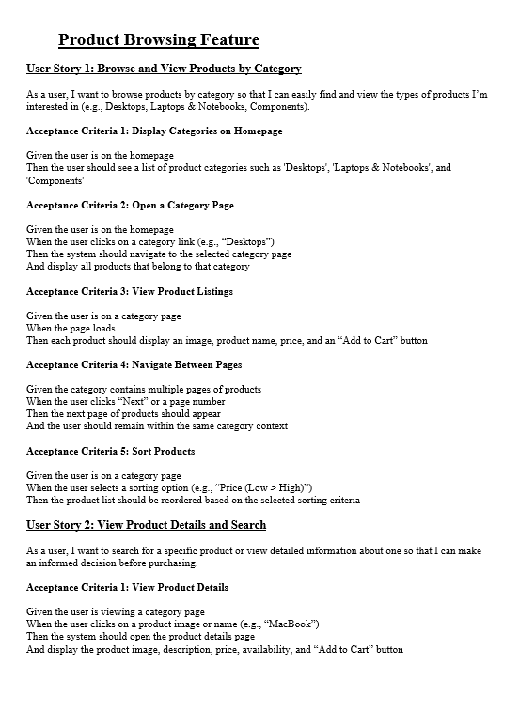

ONL3_SWD6_G3
TEST ANALYSIS
Analyzing the user story to identify testable features , and to define and prioritize associated test conditions , and dicsover ambiguous data.
01

Slide 7
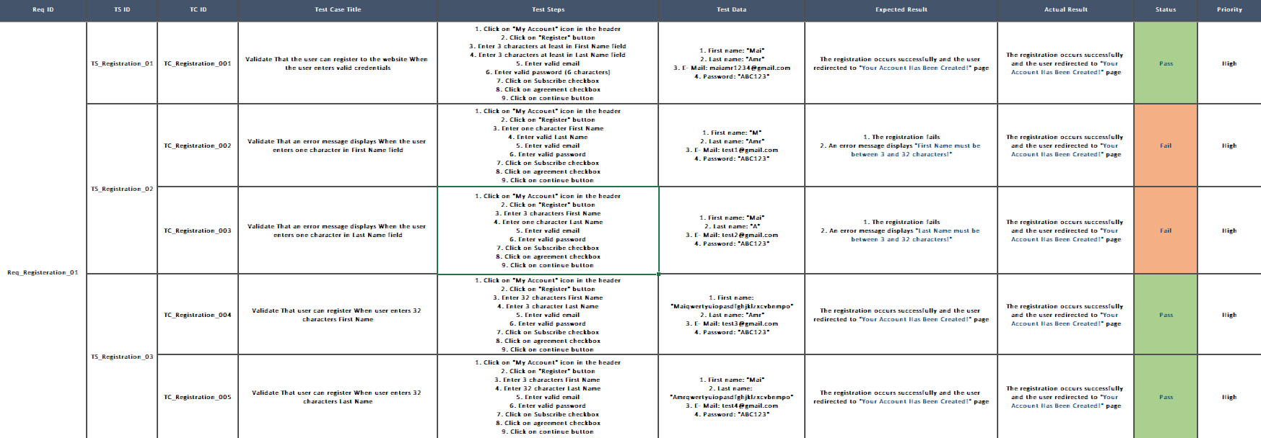
ONL3_SWD6_G3
TEST CASES

Slide 8
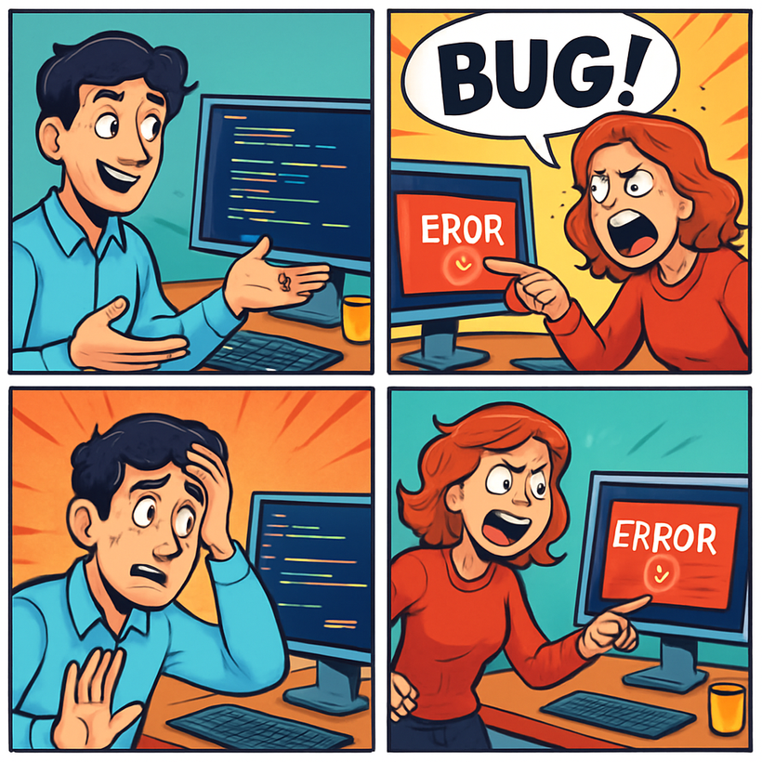
ONL3_SWD6_G3
BUG REPORT

Slide 9
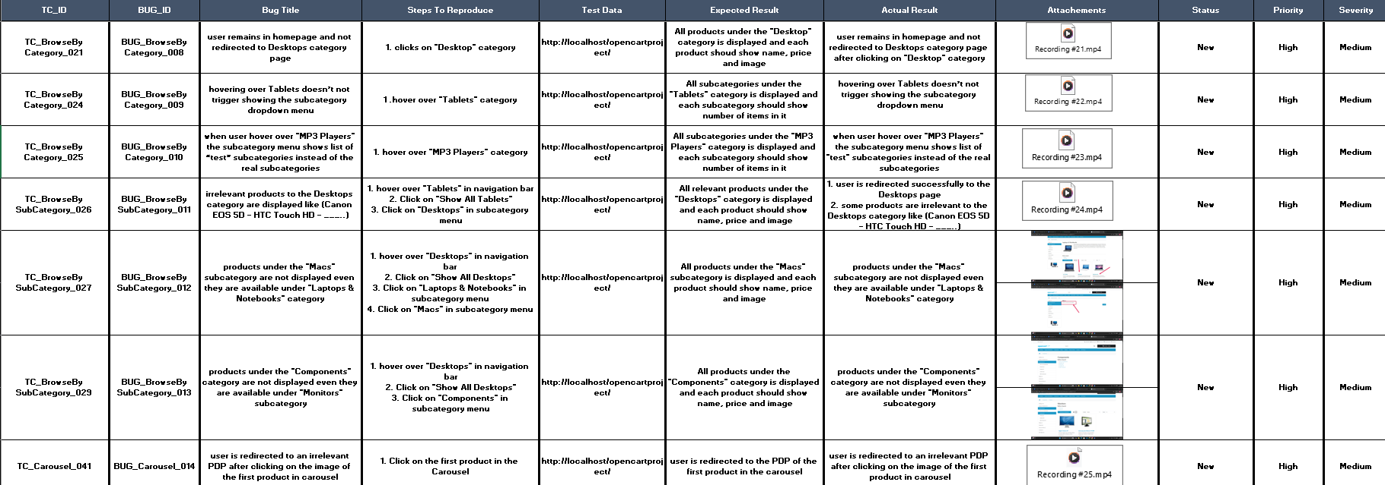
ONL3_SWD6_G3
BUG REPORT

Slide 10
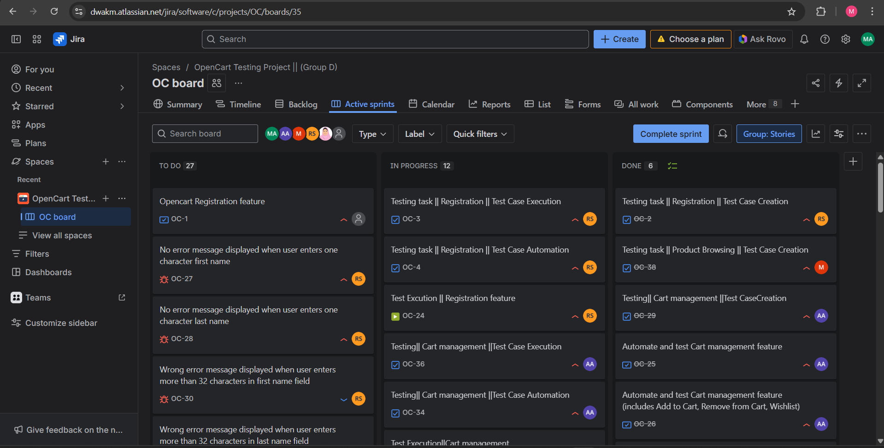
ONL3_SWD6_G3
JIRA MODEL

Slide 11


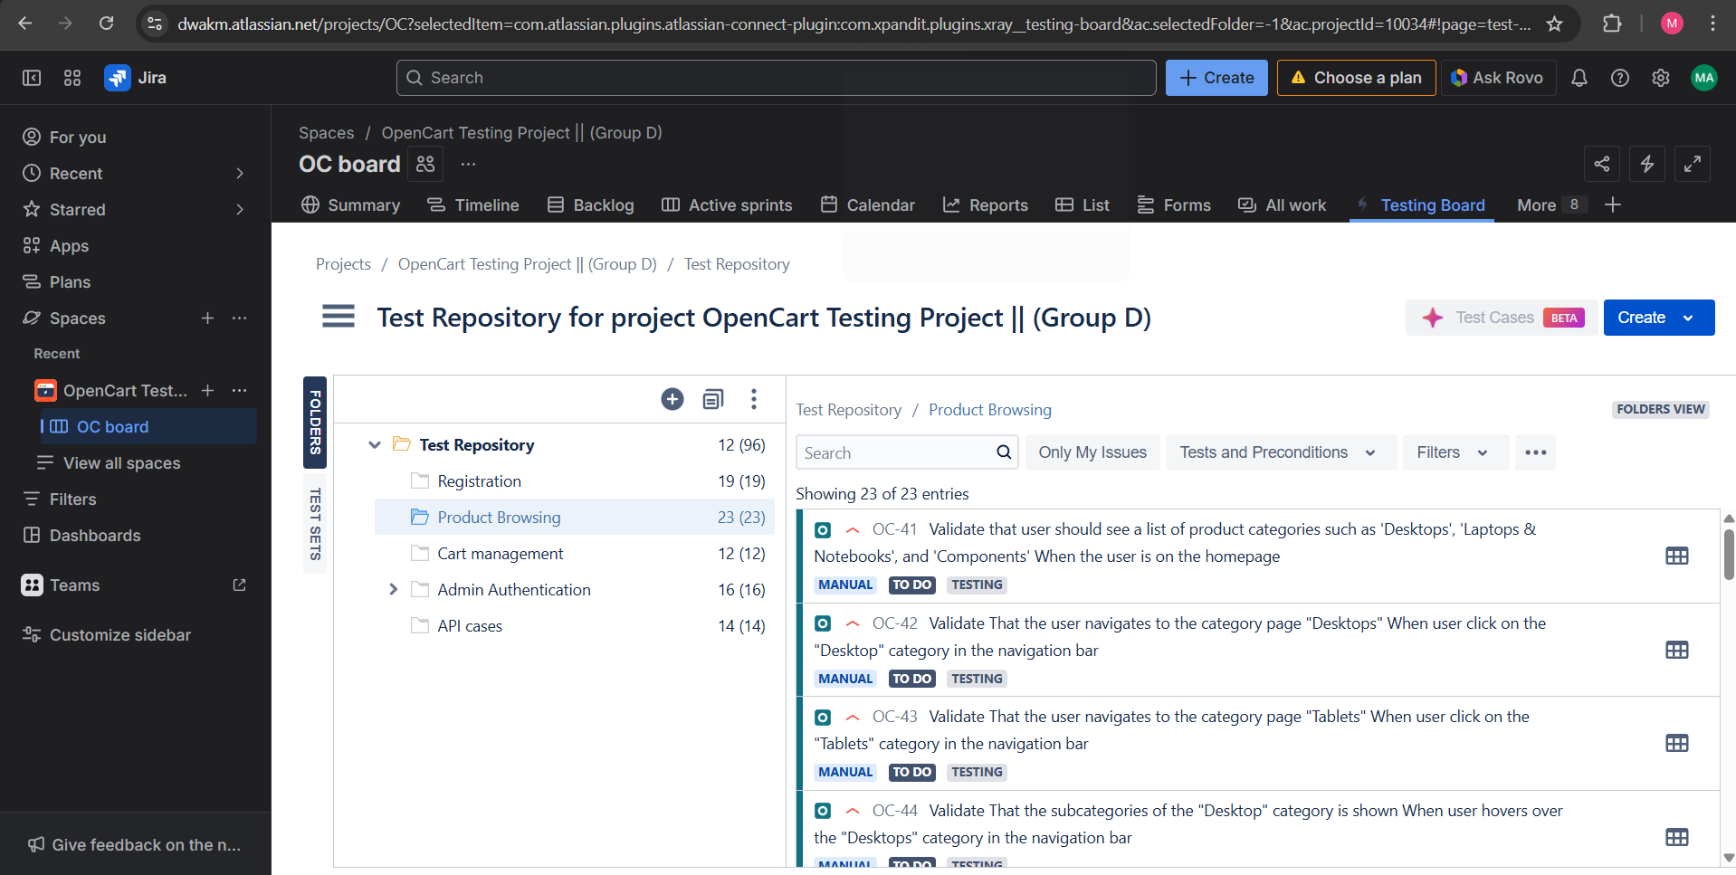
ONL3_SWD6_G3
TEST CASES (Jira)

Slide 12
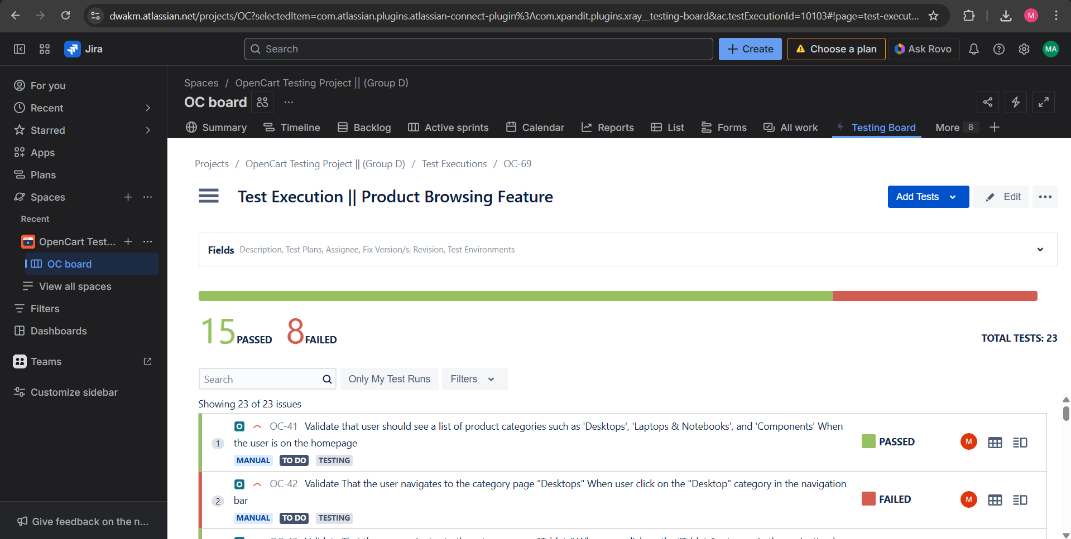
ONL3_SWD6_G3
BUG REPORT (Jira)

Slide 13

ONL3_SWD6_G3
DATABASE TESTING
Database testing is a type of software testing that focuses on verifying the accuracy, reliability, performance, and security of a database system. It ensures that the data stored in the database is consistent, valid, and can be correctly manipulated according to business requirements.

Slide 14
ONL3_SWD6_G3
THE PROCESS OF DATABASE TESTING
Environment Preparation
Test Case Design
Test Execution
Result Analysis
Reporting

Slide 15
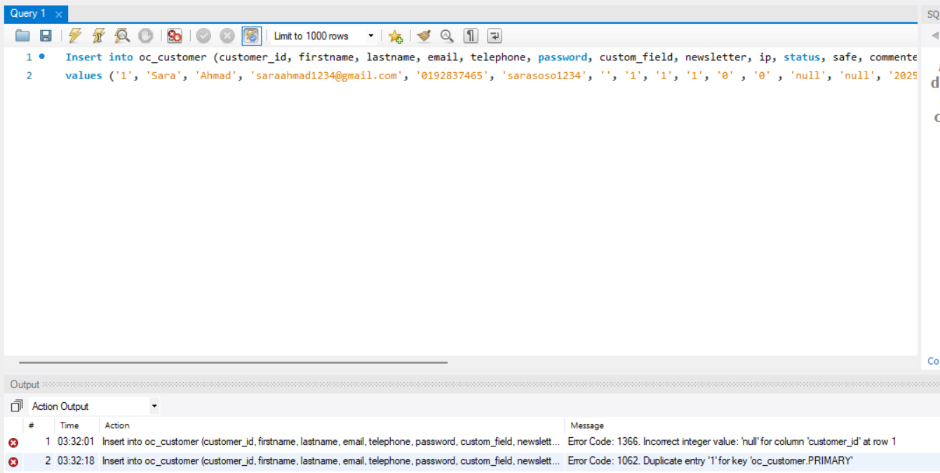
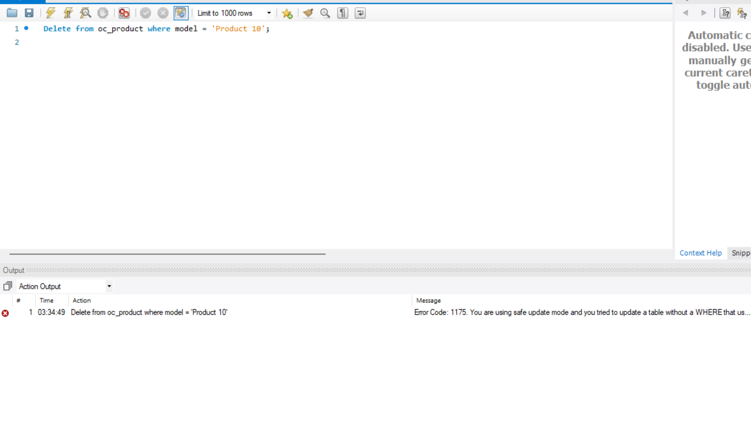
ONL3_SWD6_G3
SAMPLES

Slide 16
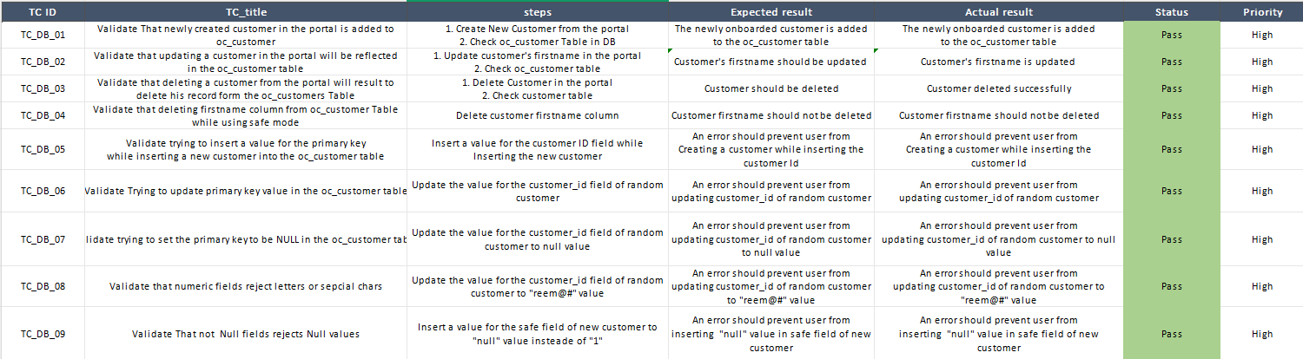
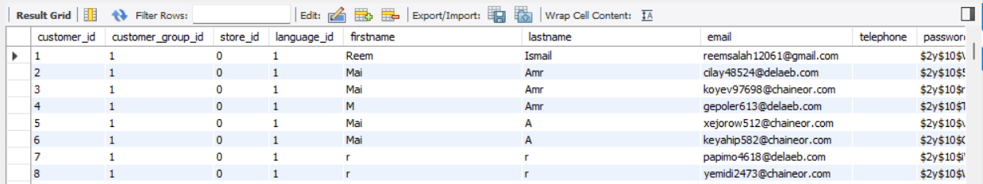
ONL3_SWD6_G3
SAMPLES

Slide 17
ONL3_SWD6_G3
API TESTING
What is API Testing?
Testing API functionality and responses
Ensuring correct request/response behavior
Validating business logic without UI

Slide 18
ONL3_SWD6_G3
OUR API PROJECT
Project Name: Automation Exercise API
Main HTTP Methods: GET – POST – PUT – DELETE
Tools: Postman - Newman

Slide 19
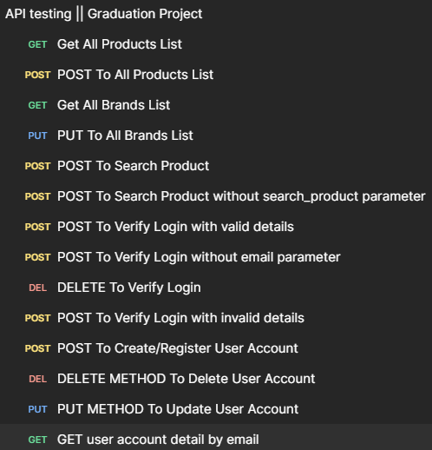




PROJECT STRUCTURE
ONL3_SWD6_G3
Browsing (4 request)
Search (2 request)
Authentication (8 request)

Slide 20
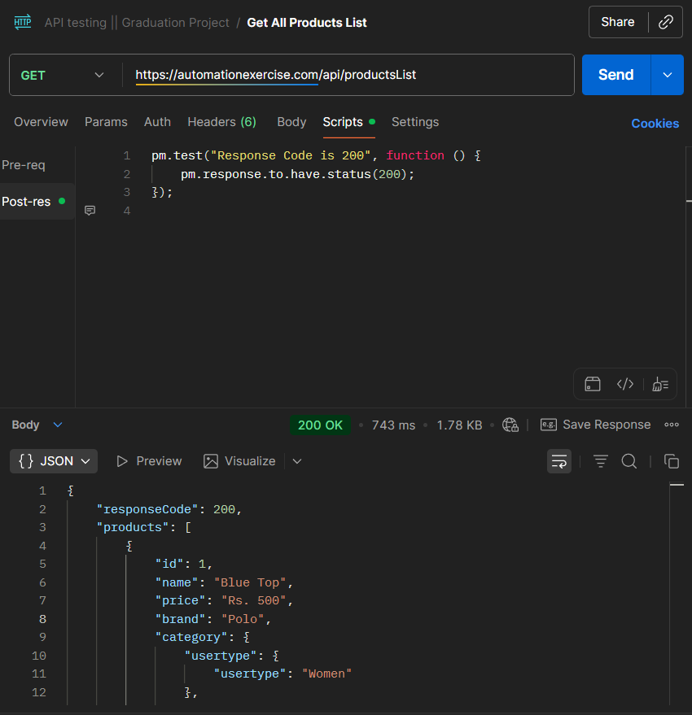
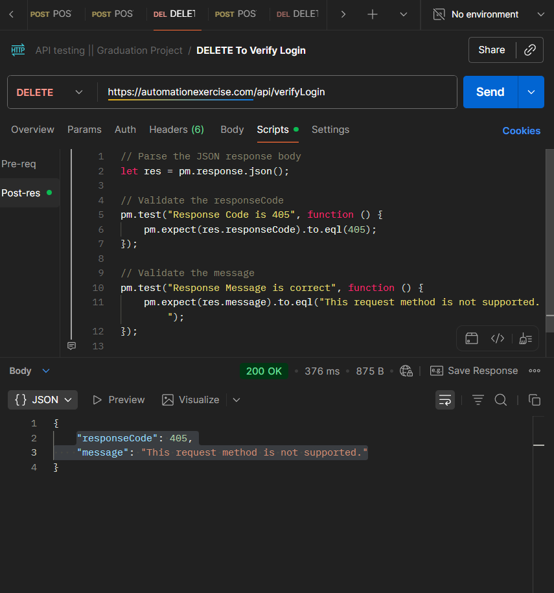
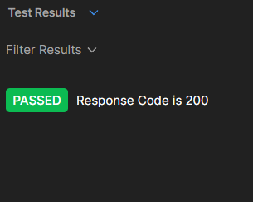
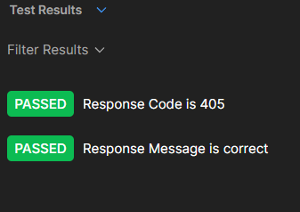
ONL3_SWD6_G3
SAMPLES

Slide 21
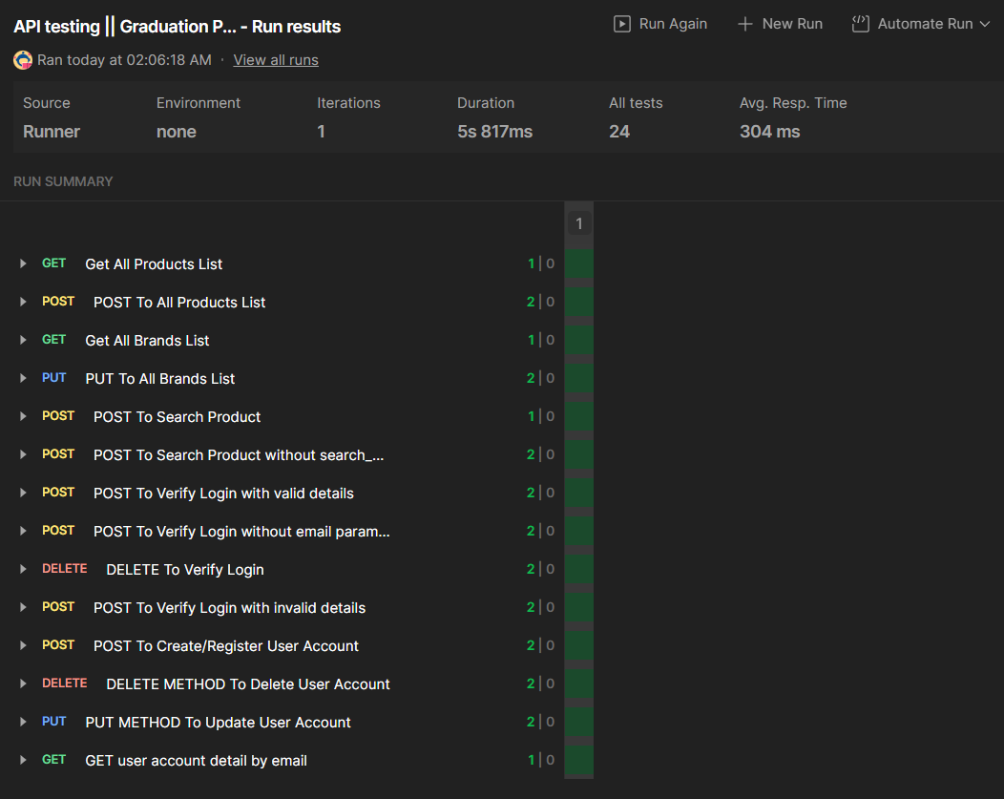
ONL3_SWD6_G3
RUNNING COLLECTION

Slide 22
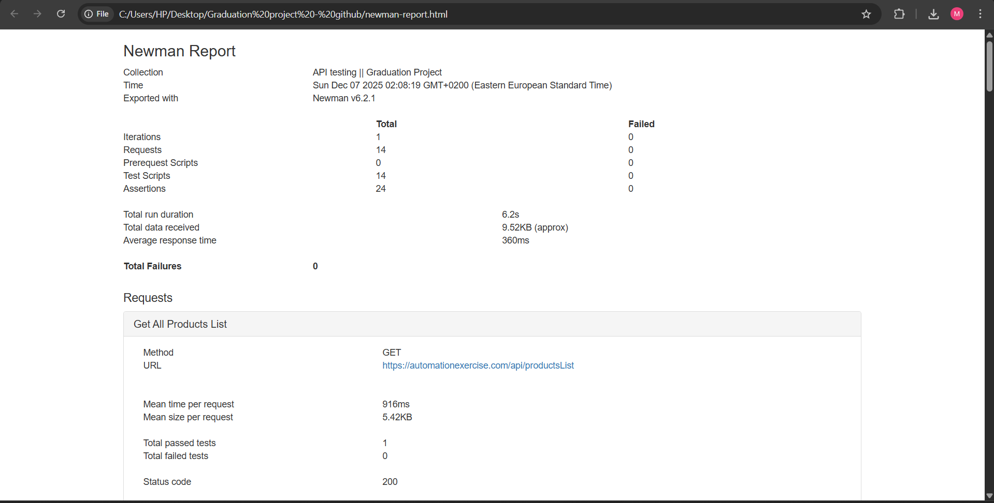
NEWMAN REPORT
ONL3_SWD6_G3

Slide 23

ONL3_SWD6_G3
AUTOMATION TESTING

Slide 24






ONL3_SWD6_G3
TOOLS
Page 33

Slide 25
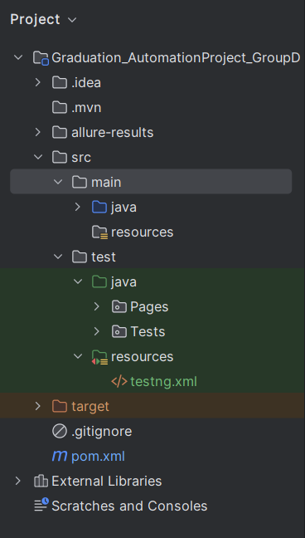

Project Structure

Slide 26
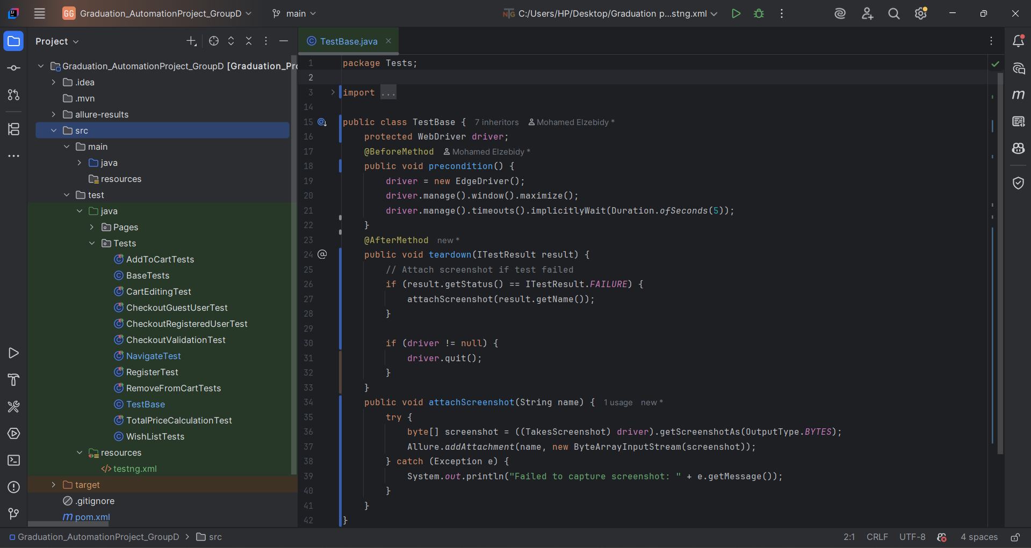
BASETEST

Slide 27
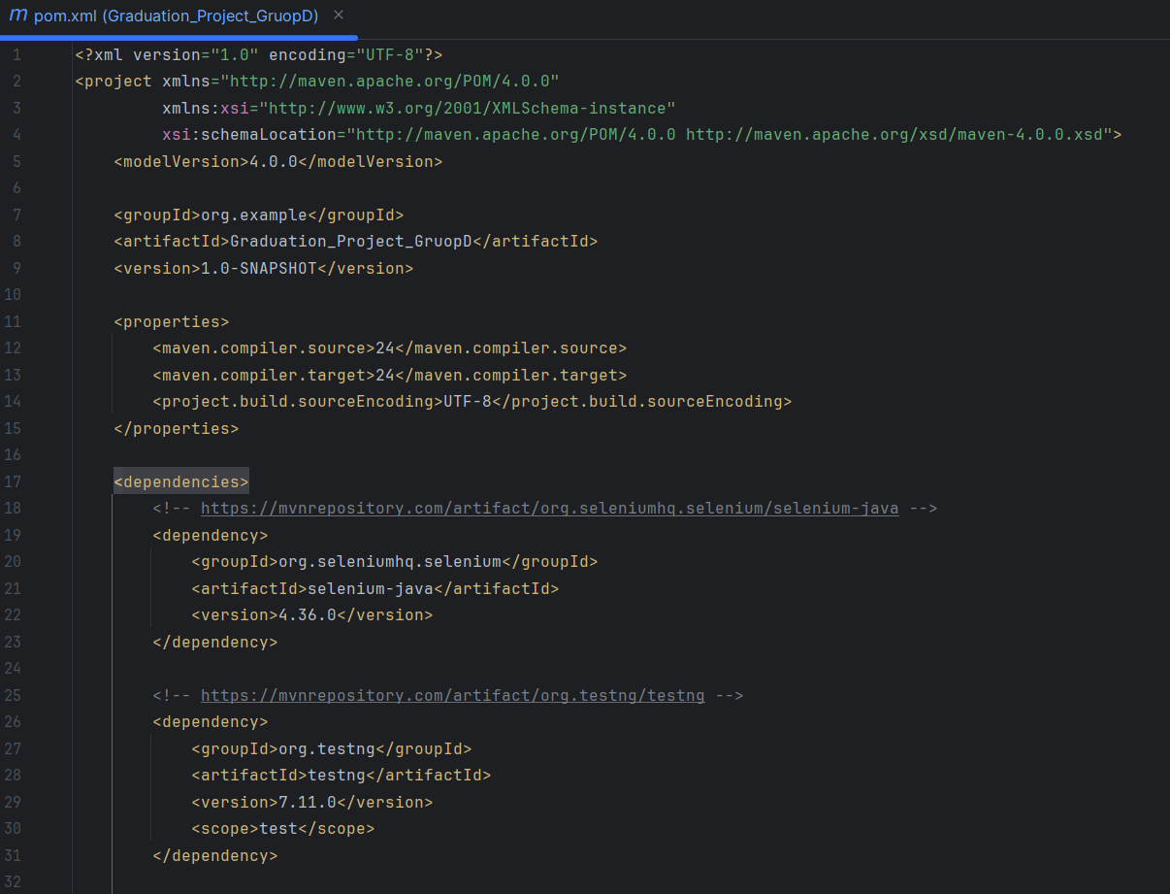
POM.XML
DEPENDENCIES

Slide 28
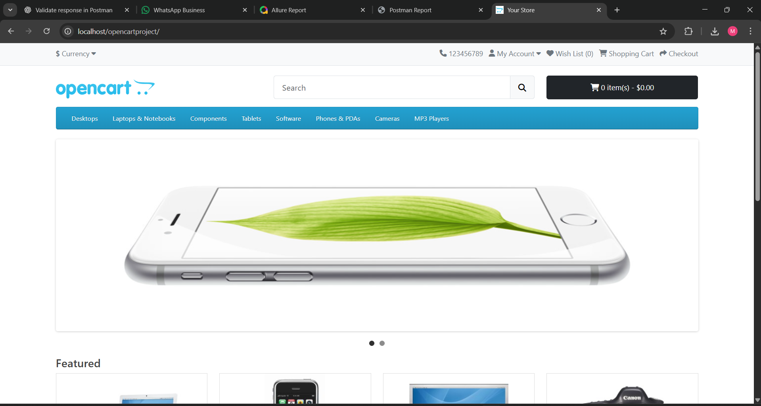
HOME PAGE

Slide 29
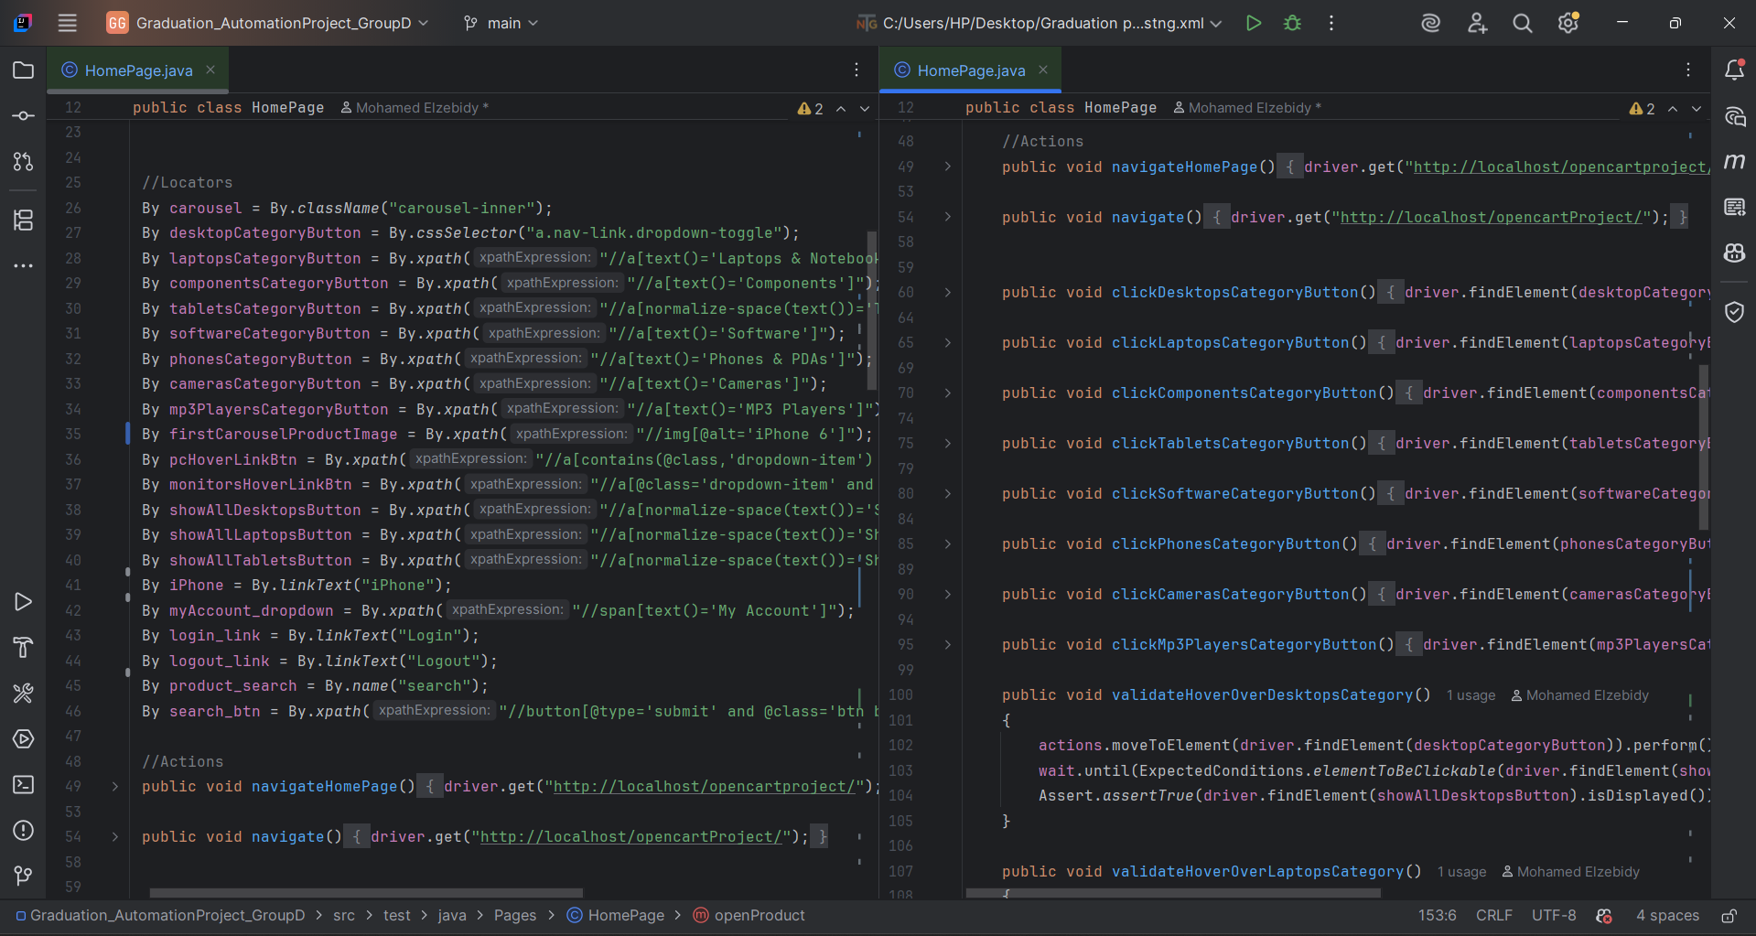
HOME PAGE

Slide 30
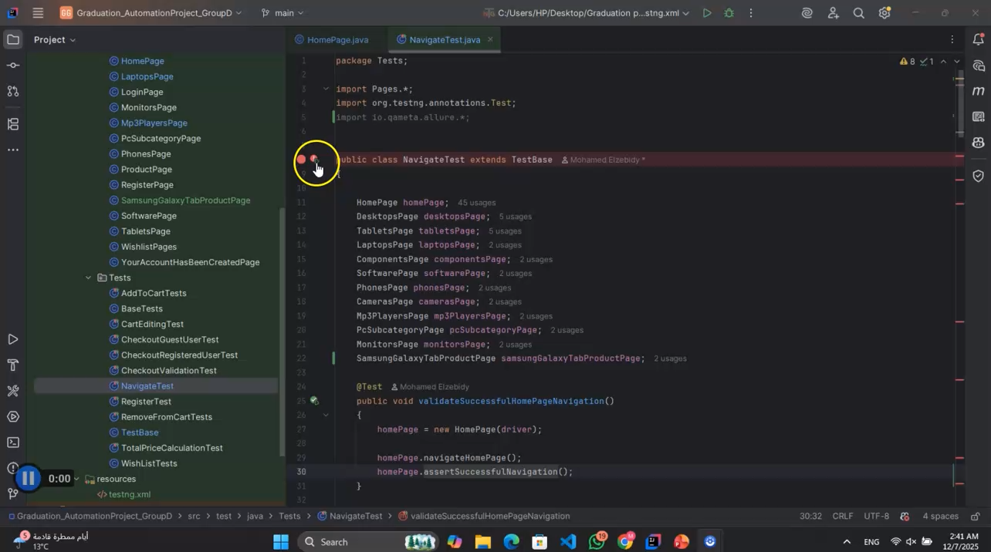
NAVIGATION FEATURE

Slide 31
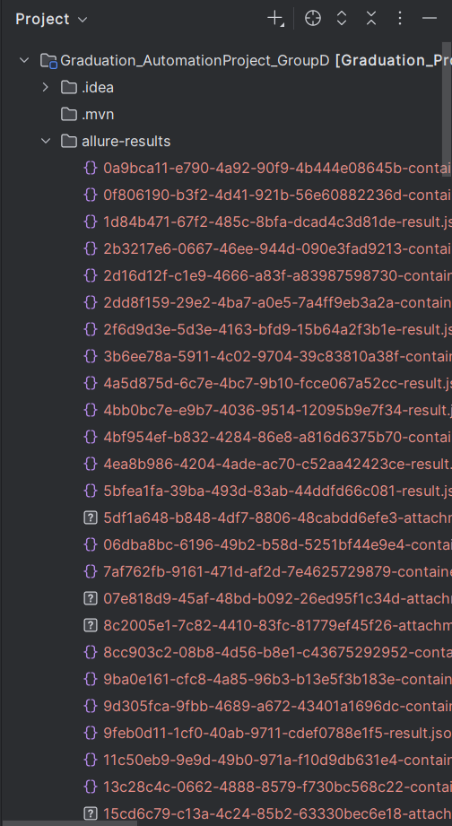
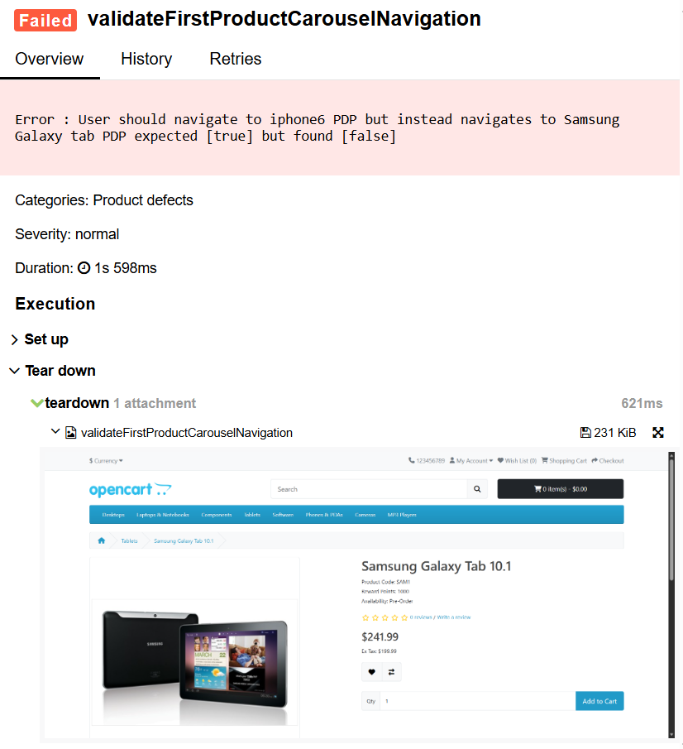
ALLURE REPORT
ATTACHED SCREENSHOT

Slide 32
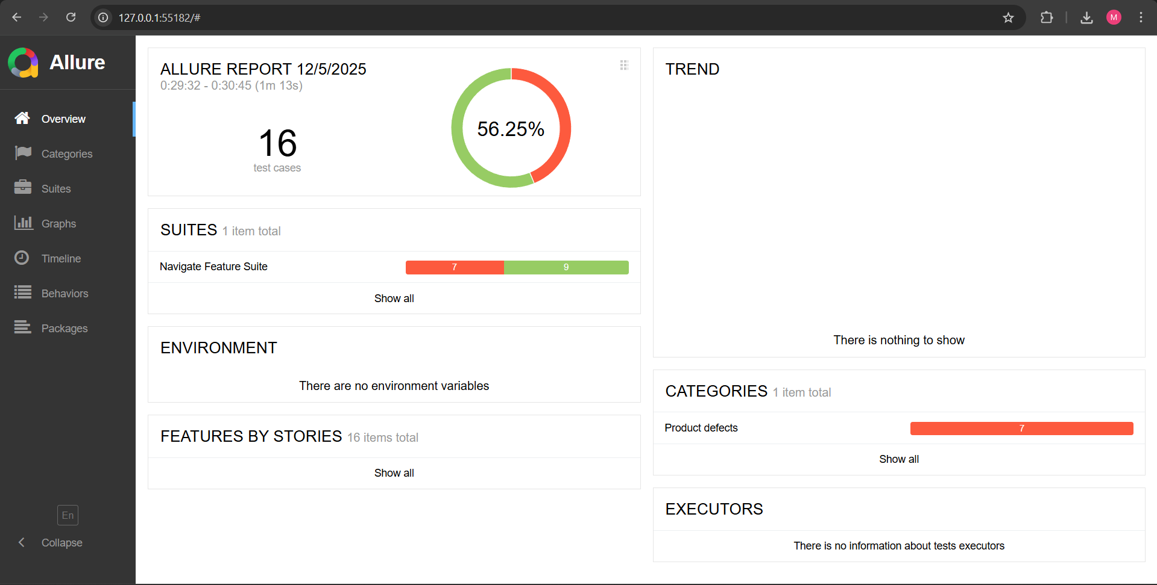
ALLURE REPORT

Slide 33
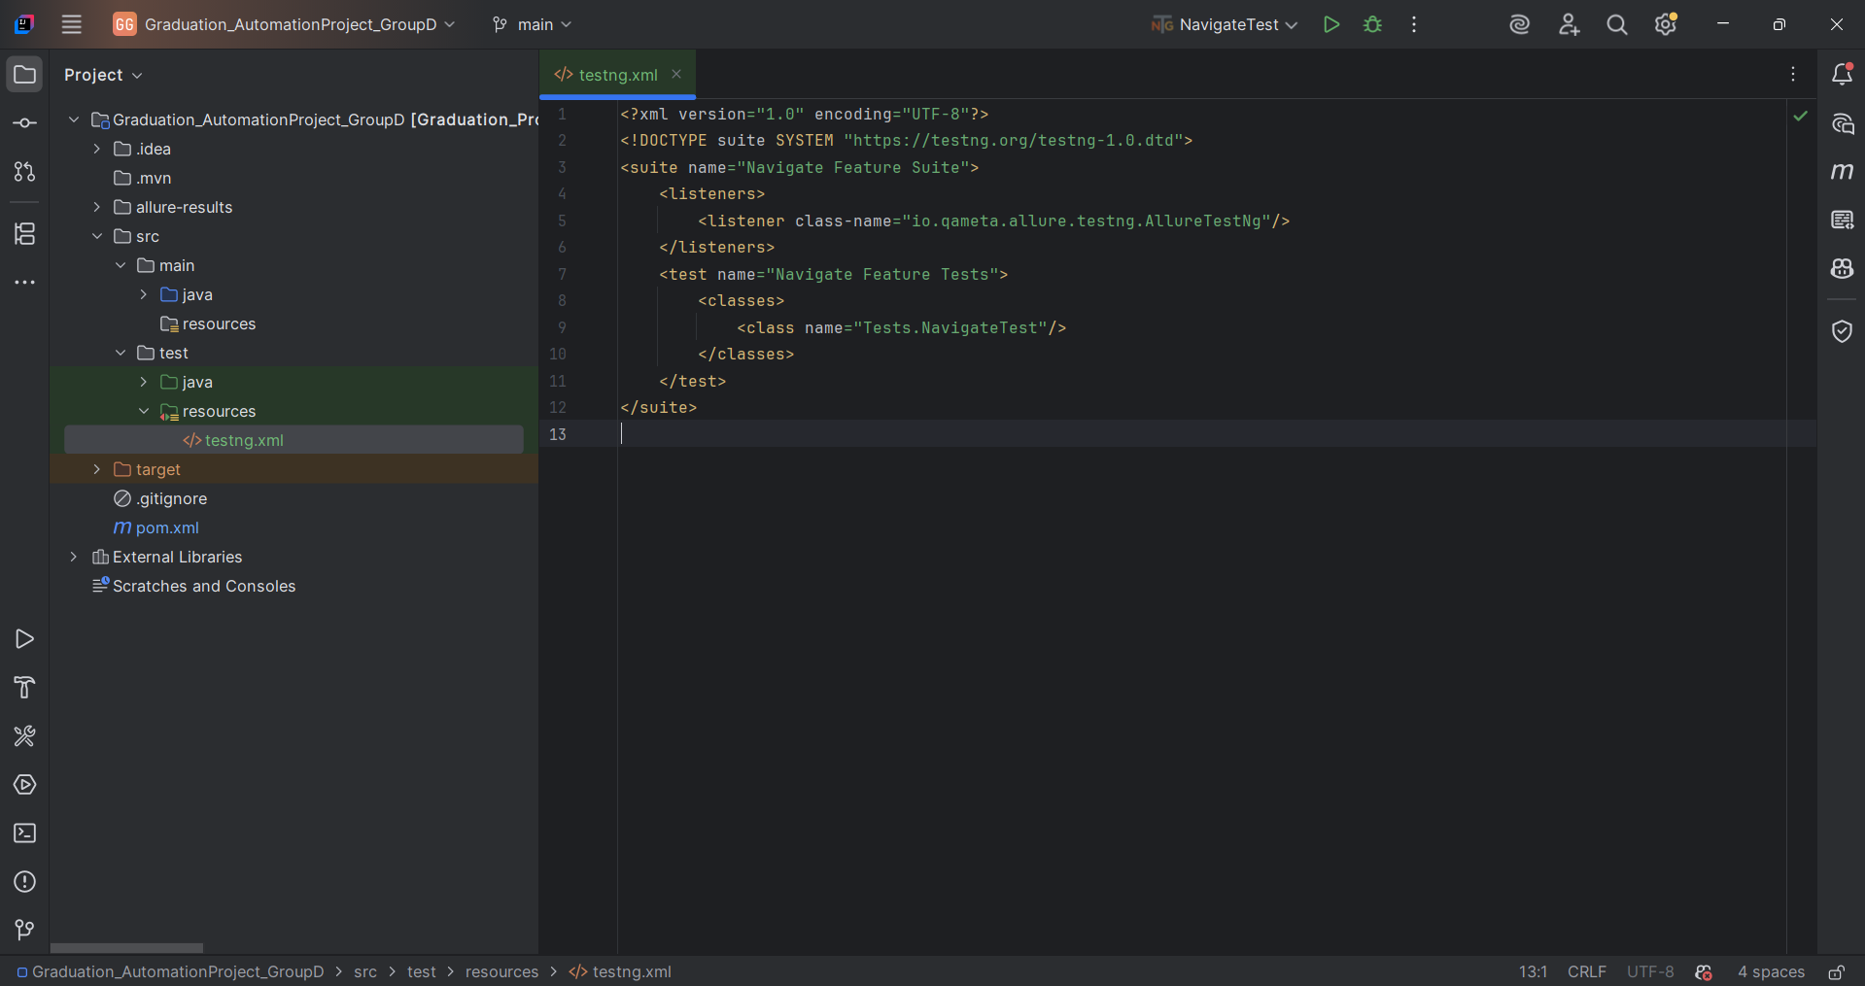
TESTNG.XML
Page 53

Slide 34

DEPI | 2025
THANK YOU
ONL3_SWD6_G3

